Slide 1




EPIC GitHub Tutorial (Part 2):
Contributing to UFS/EPIC Repositories
https://github.com/NOAA-EPIC/training-github
EARTH PREDICTION INNOVATION CENTER (EPIC)

Slide 2
Welcome!
This is Part 2 of the EPIC GitHub Tutorial on Contributing to UFS/EPIC Repositories
View Part 1: https://epic.noaa.gov/tutorials/?playlist=afde205&video=9e65c0d
All the materials and tutorial presentations (Part 1 and Part 2) could be found at https://github.com/NOAA-EPIC/training-github
Get all the materials and tutorial presentations (Part 1, Part 2):
git clone https://github.com/NOAA-EPIC/training-github.git cd ./training-github
The directory ./training-github/ will contain all of the materials for the tutorial.
EARTH PREDICTION INNOVATION CENTER (EPIC)
Notes:
Please navigate to https://github.com/NOAA-EPIC/training-github
Note this tutorial assumes you are on a Mac or Linux-like system
Complete all prerequisite steps

Slide 3
Welcome!
This is the second part of the GitHub Tutorial on Contributing to UFS/EPIC Repositories.
All the materials and tutorial presentations (Part 1 and Part 2) could be found at https://github.com/NOAA-EPIC/training-github
Complete all prerequisite steps as listed in a README.md : - git installed (via Homebrew for Mac OS, “git-bash” for Windows)
- basic command-line interface (CLI) commands
- opened a GitHub account
EARTH PREDICTION INNOVATION CENTER (EPIC)
Notes:
Please navigate to https://github.com/NOAA-EPIC/training-github
Note this tutorial assumes you are on a Mac or Linux-like system
Complete all prerequisite steps

Slide 4
Recap of the Part 1: Git and GitHub Basics
Basic Git and GitHub terms and concepts introduced
Basic Git configurations and commands discussed
Example given on setting up a SSH key pair for GitHub authentication
A new local repository was created, initialized, pushed to GitHub
Modifications made, committed, local changes tracked, logs viewed
A new branch made, different branches compared
Started topic: public GitHub repositories, forks and clones
EARTH PREDICTION INNOVATION CENTER (EPIC)

Slide 5
Part 1.
Basic Git Terms and Concepts
Git: A program; a free, open-source version control system
Version control system (VCS): software providing management of changes to computer programs, documentation, web sites, etc.
GitHub (github.com): The host website for many free and open-source repositories, including numerous ones by NOAA
Repository (repo): a set of code, documents, website(s), etc., that are version controlled
Branch: a working version of a repository with its own change history
EARTH PREDICTION INNOVATION CENTER (EPIC)

Slide 6
Basic Local Git Commands (git + <command>)
config: configure your git experience
init: create a new local repository in the existing directory tracked by git
add: add files to be tracked by git
commit: save changes you have made to the repository
branch: verify a current branch, copy the current branch to create a new one
checkout: check out a specific branch within a repository
log: show recorded (committed) change history to the repository
status: show changes to the repository since the recent commit
diff: show local file/line-by-line changes to the repository since the recent commit
EARTH PREDICTION INNOVATION CENTER (EPIC)

Slide 7
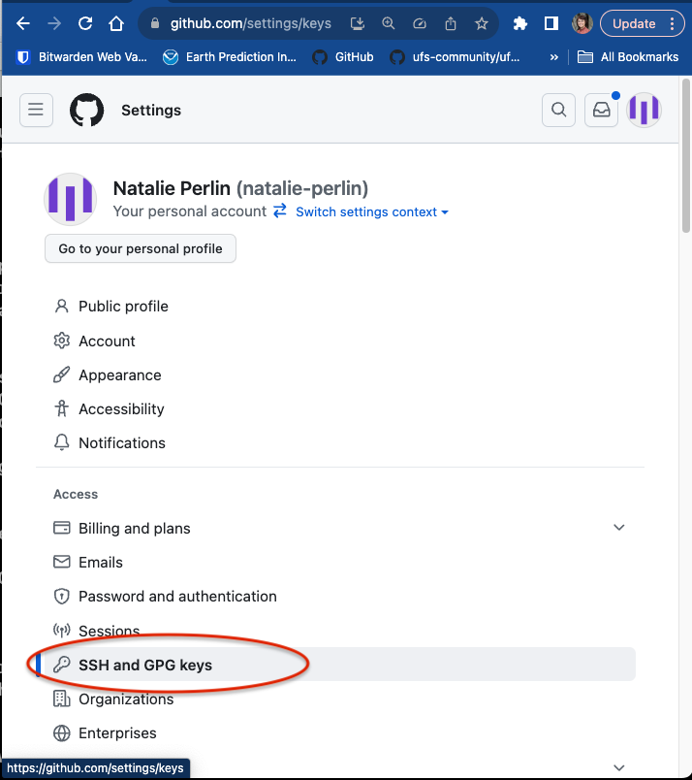
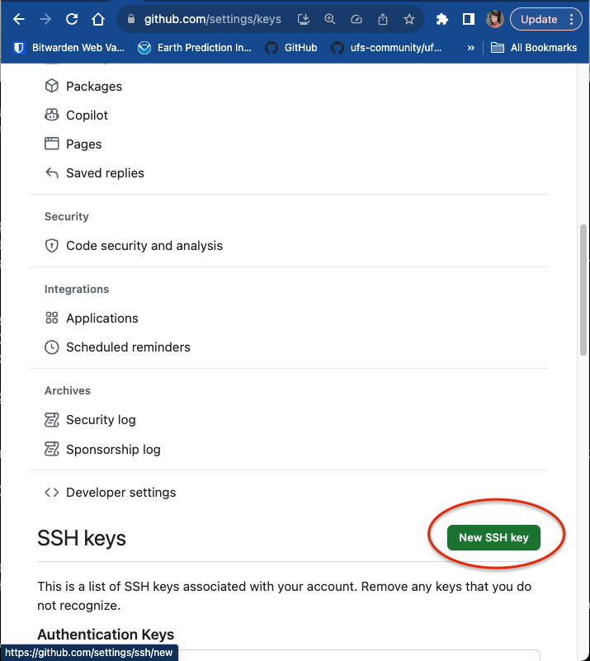
Generate SSH key pair for easy Git/GitHub communication
From Settings, on the left, click on “SSH and GPG keys”, then “New SSH key”
In a local terminal, go to ~/.ssh and generate a key pair:
ssh-keygen -t rsa -b 4096
Name your key (full path) or use a default id_rsa name
Copy the public key from the output:
cat id_rsa.pub
Paste the output into the “Key” portion of the GitHub page
Give it a title and click “Add SSH key”
more help: https://docs.github.com/en/authentication/connecting-to-github-with-ssh/generating-a-new-ssh-key-and-adding-it-to-the-ssh-agent
EARTH PREDICTION INNOVATION CENTER (EPIC)

Slide 8
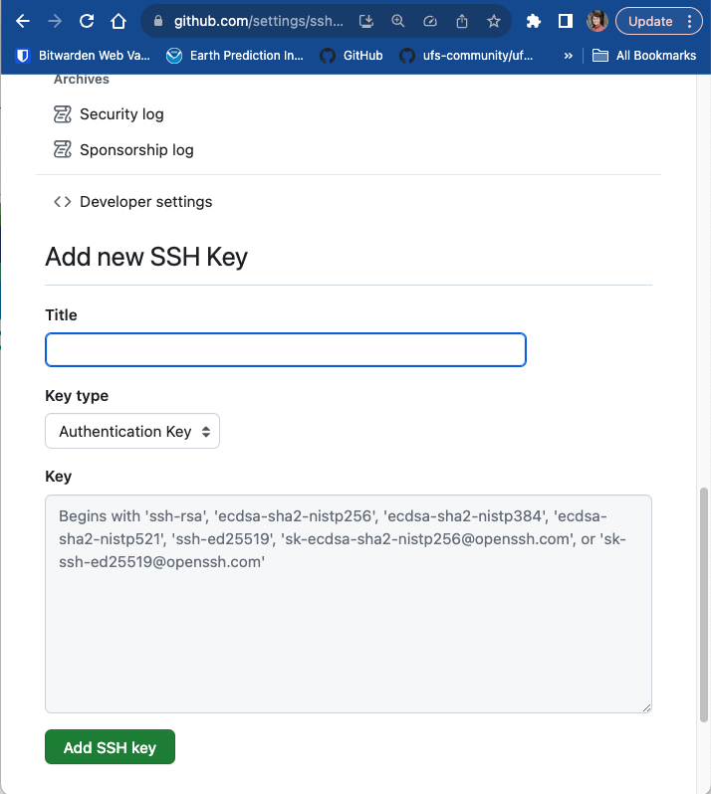
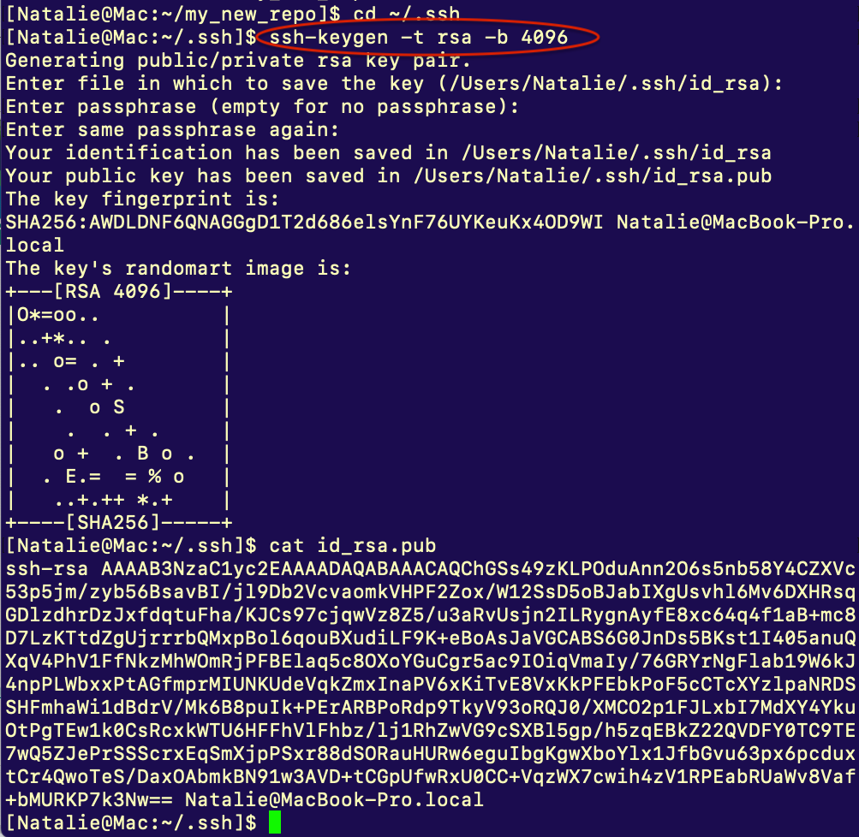
Generate SSH key pair for easy Git/GitHub communication
GitHub Settings on the left -> click on “SSH and GPG keys”, then “New SSH key”
In a local terminal, go to ~/.ssh and generate a key pair:
ssh-keygen -t rsa -b 4096
Name your key (full path) or use a default id_rsa name
Copy the public key from the output:
cat id_rsa.pub
Paste the output into the “Key” portion of the GitHub page
Give it a title and click “Add SSH key”
more help: https://docs.github.com/en/authentication/connecting-to-github-with-ssh/generating-a-new-ssh-key-and-adding-it-to-the-ssh-agent
EARTH PREDICTION INNOVATION CENTER (EPIC)

Slide 9
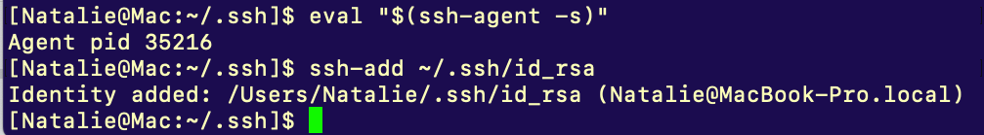
Add a private SSH key to your local ssh agent
(an example for Mac OS)
Start a new SSH agent:
eval "$(ssh-agent -s)"
Add a new private key to the ssh agent (Mac OS):
ssh-add ~/.ssh/id_rsa
Now pushes (uploads) to your GitHub repositories will not require a password
more help on SSH Keys: https://www.ssh.com/academy/ssh/keygen
https://docs.github.com/en/authentication/connecting-to-github-with-ssh/generating-a-new-ssh-key-and-adding-it-to-the-ssh-agent
EARTH PREDICTION INNOVATION CENTER (EPIC)

Slide 10
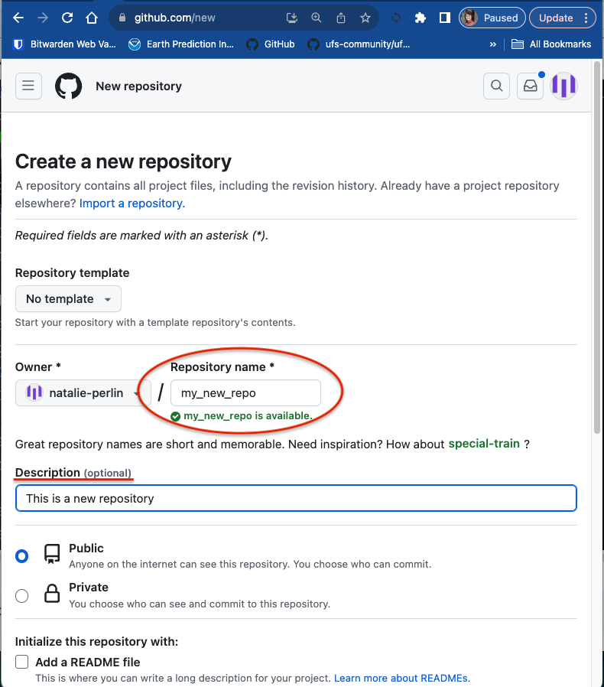
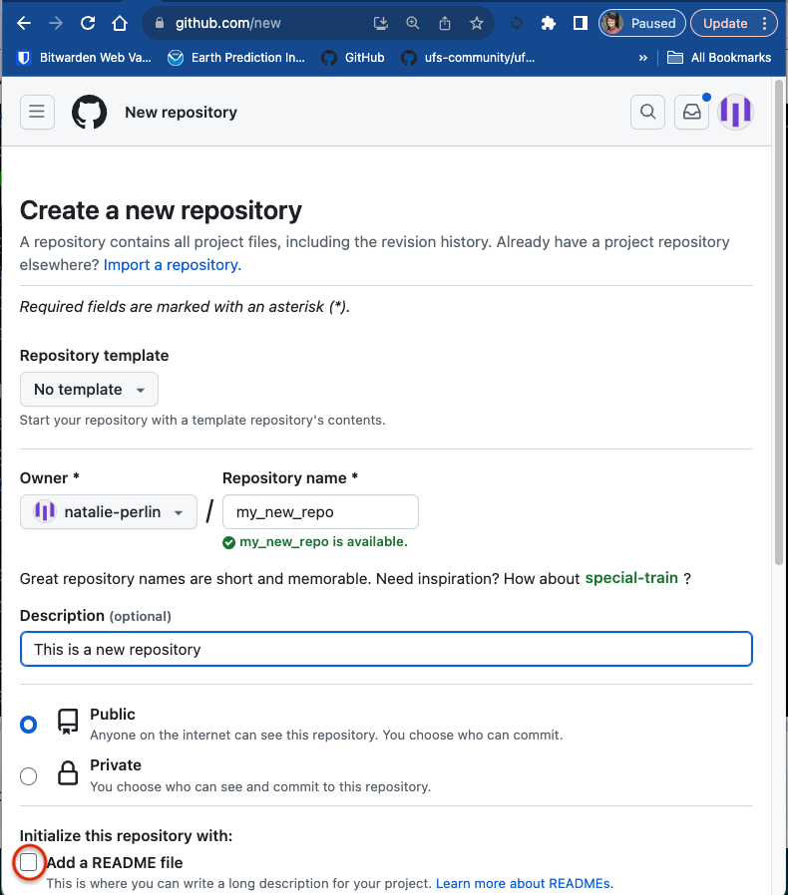
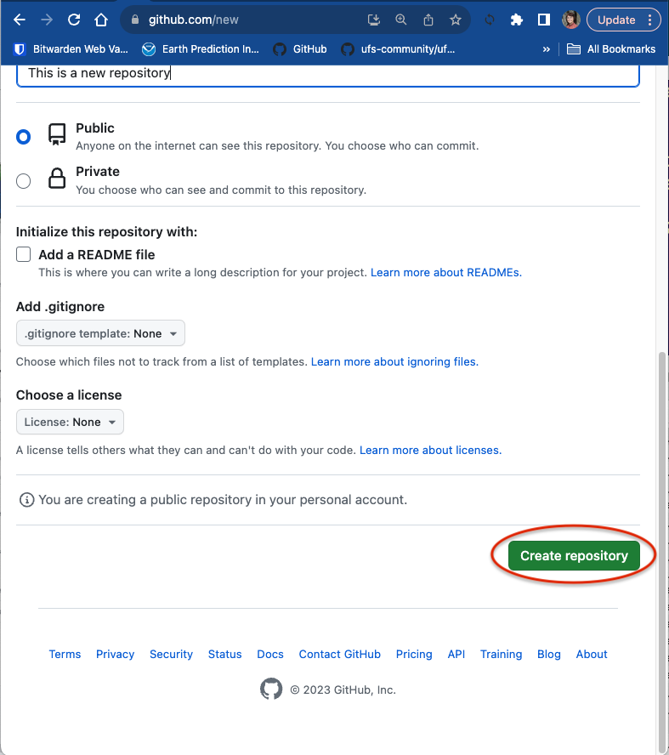
Creating a repository on GitHub
Head to https://github.com/new
Give your new repository a unique name (my_new_repo) and optionally a description
Since we will be pushing (uploading) our repository from the terminal, do not select “Add a README file”
Scroll down and click “Create repository”
EARTH PREDICTION INNOVATION CENTER (EPIC)

Slide 11
Pushing a Repository to GitHub
New gits commands:
push: upload local repository content with committed changes to a remote repository
remote: manage a list of remote entries tracked by a local repository
remote -v : query a remote repository or repositories tracked
remote add origin: "origin" remote refers to the default remote repository name
EARTH PREDICTION INNOVATION CENTER (EPIC)

Slide 12
GitHub Tutorial Part 2: Working with Remote Repositories
UFS/EPIC Public Repositories, Forks and Clones
Branches and Tags
Git Workflow: from Local Spaces to Remote Repos
Fetching and Merging Remote Branches
Making Pull Requests
Resolve conflicts
GitHub Issues and Discussions
EARTH PREDICTION INNOVATION CENTER (EPIC)

Slide 13
Common GitHub repositories used by UFS community
https://github.com/ufs-community/ufs-weather-model
https://github.com/ufs-community/ufs-srweather-app
https://github.com/ufs-community/land-DA_workflow
https://github.com/ufs-community/uwtools
https://github.com/ufs-community/UFS_UTILS
https://github.com/ufs-community/ccpp-physics (forked from NCAR/ccpp-physics)
https://github.com/hafs-community/HAFS (forked from hafs-communityHAFS)
https://github.com/ufs-community/global-workflow-AR (NOAA-EMC/global-workflow)
https://github.com/NOAA-EMC/UPP
https://github.com/noaa-oar-arl/NEXUS
https://github.com/NOAA-EMC/AQM-utils
https://github.com/JCSDA/spack-stack
EARTH PREDICTION INNOVATION CENTER (EPIC)

Slide 14
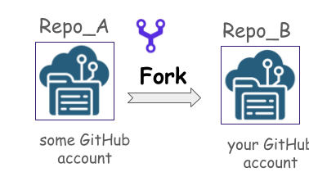
GitHub Repositories: Forks and Clones
fork: a separate copy of another existing repository
created in a remote location, e.g., GitHub account
could be synced with the primary repository
contribute to your fork not affecting the original repo
clone: a linked local copy of an existing repository
a repository code is downloaded to your local machine
done through the command ‘git clone’
references to an original target/remote repository
EARTH PREDICTION INNOVATION CENTER (EPIC)

Slide 15
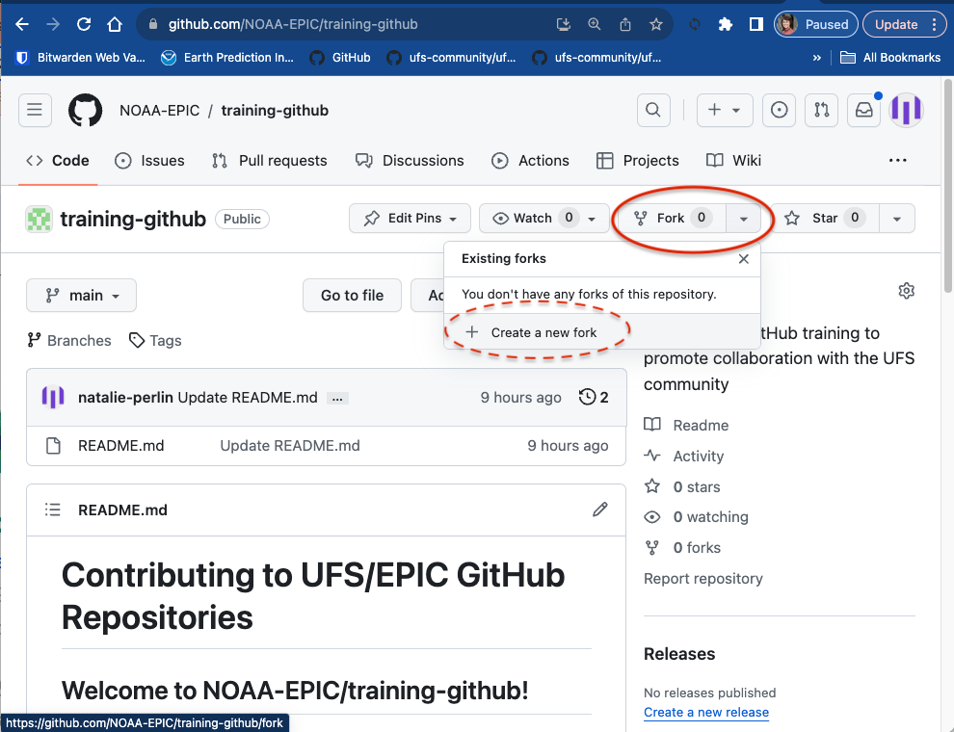
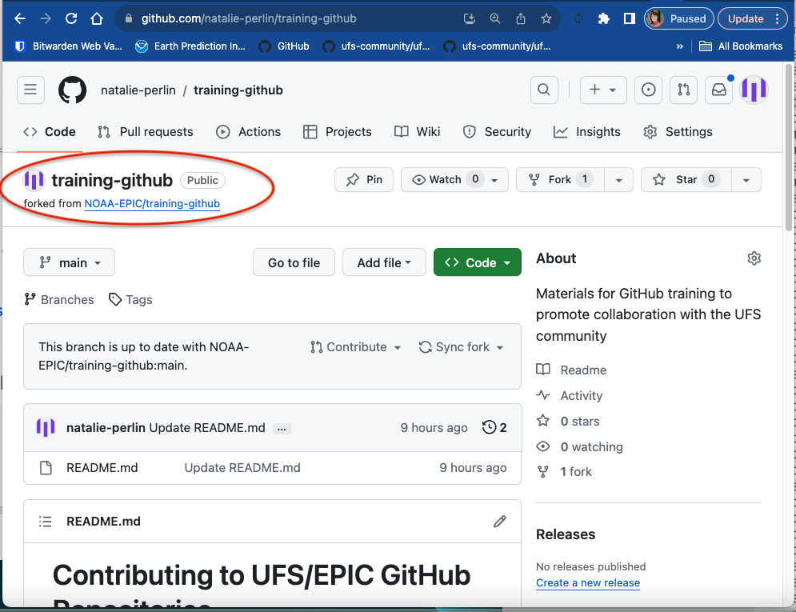
GitHub Repositories: Forks and Clones
fork: a separate copy of another existing repository
created in a remote location, e.g., GitHub account
could be synced with the primary repository
contribute to your fork not affecting the original repo
clone: a linked local copy of an existing repository
a repository code is downloaded to your local machine
done through the command ‘git clone’
references to an original target/remote repository
EARTH PREDICTION INNOVATION CENTER (EPIC)

Slide 16
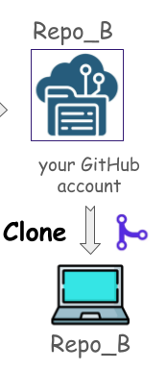
GitHub Repositories: Forks and Clones
fork: a separate copy of another existing repository
created in a remote location, e.g., GitHub account
could be synced with the primary repository
contribute to your fork not affecting the original repo
clone: a linked local copy of an existing repository
a repository code is downloaded to your local machine
done through the command ‘git clone’
references to an original target/remote repository
EARTH PREDICTION INNOVATION CENTER (EPIC)

Slide 17
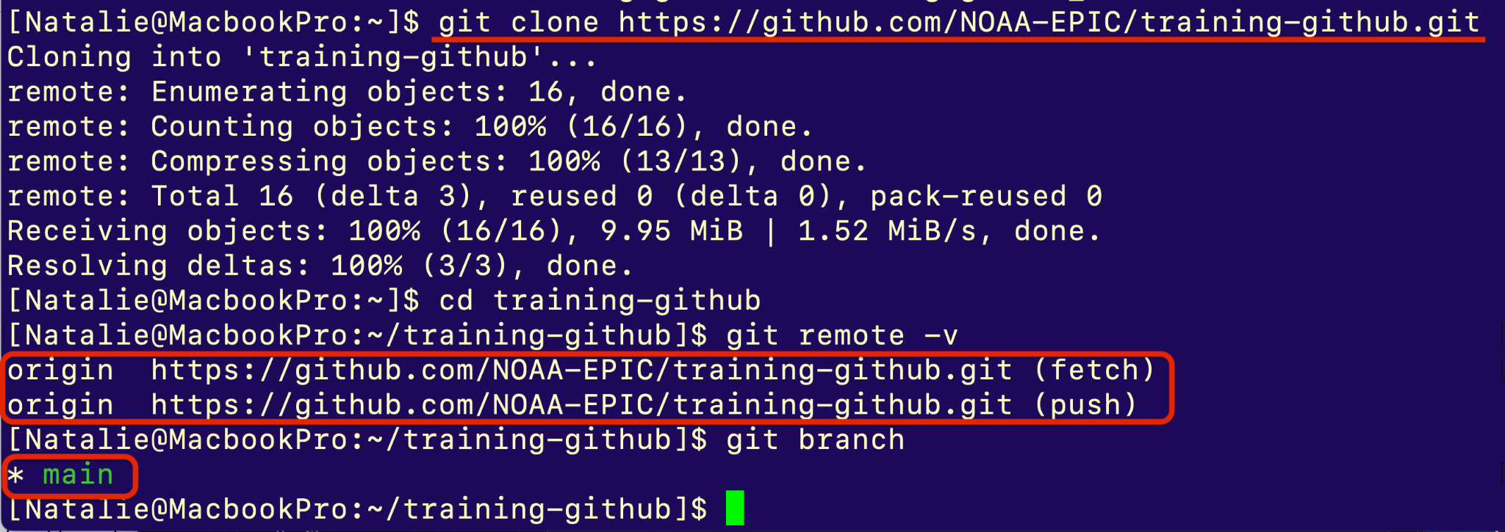
GitHub Repositories: Forks and Clones
fork: a separate copy of another existing repository
created in a remote location, e.g., GitHub account
could be synced with the primary repository
contribute to your fork not affecting the original repo
clone: a linked local copy of an existing repository
a repository code is downloaded to your local machine
done through the command ‘git clone’
references to an original target/remote repository
EARTH PREDICTION INNOVATION CENTER (EPIC)

Slide 18
Contributing to an open GitHub repository
FORK the original repository to your GitHub account
CLONE your repository to a local machine
Make changes to your cloned repository
PUSH them to your GitHub repository: it then be synced to your changes
Create a PULL REQUEST (PR) to merge your changes with the original repository: it means making a request to the repository owner and telling them “Please check my changes and merge them if you like it”
EARTH PREDICTION INNOVATION CENTER (EPIC)

Slide 19


Contributing to an open-source GitHub project
Repo_A
Repo_B
fork
pull request
some GitHub account
your GitHub account
clone
(make changes)
push
Repo_B
EARTH PREDICTION INNOVATION CENTER (EPIC)

Slide 20
GitHub Repositories: Branches and Tags
Branches:
used for concurrent development, bux fixes, implementation features
can be moved or deleted
often expected to be merged back into original branch
feature branches could have a long span
Tags:
mark specific points in history to capture software versions
typically used to mark stable points that correspond to specific releases
permanent and don’t change after they are created
used to label a specific commit
EARTH PREDICTION INNOVATION CENTER (EPIC)
Notes:
Git Branches:
Purpose:
Git branches are used to separate work on features or bug fixes, allowing developers to work on different parts of a project without interfering with each other.
Long-lived development efforts are often done on branches and are expected to be merged back into the main branch upon completion.

Slide 21
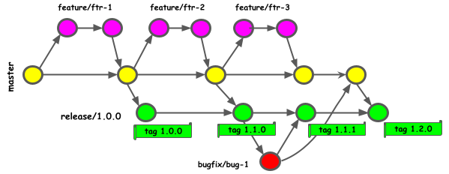
GitHub Repositories: Branches and Tags
feature branch
tag
bug fix branch
EARTH PREDICTION INNOVATION CENTER (EPIC)

Slide 22
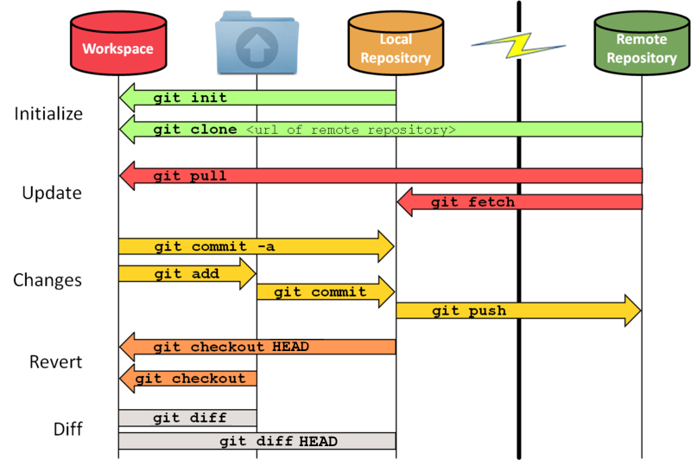
Git workflow: from local spaces to remote repos
Local Git has three stages:
Work area - Staging area - HEAD
Working area - your local directory
git clone/init
git checkout
git pull
Staging area: what is to be committed
git add/mv/rm/
git checkout
git reset <file>/>commit>
Local repository (HEAD*):
default branch of the remote repository
fetch updates from a remote repo
push changes to a remote repo
* - HEAD term also has a wider use in Git
Working
Staging
HEAD
index
EARTH PREDICTION INNOVATION CENTER (EPIC)

Slide 23
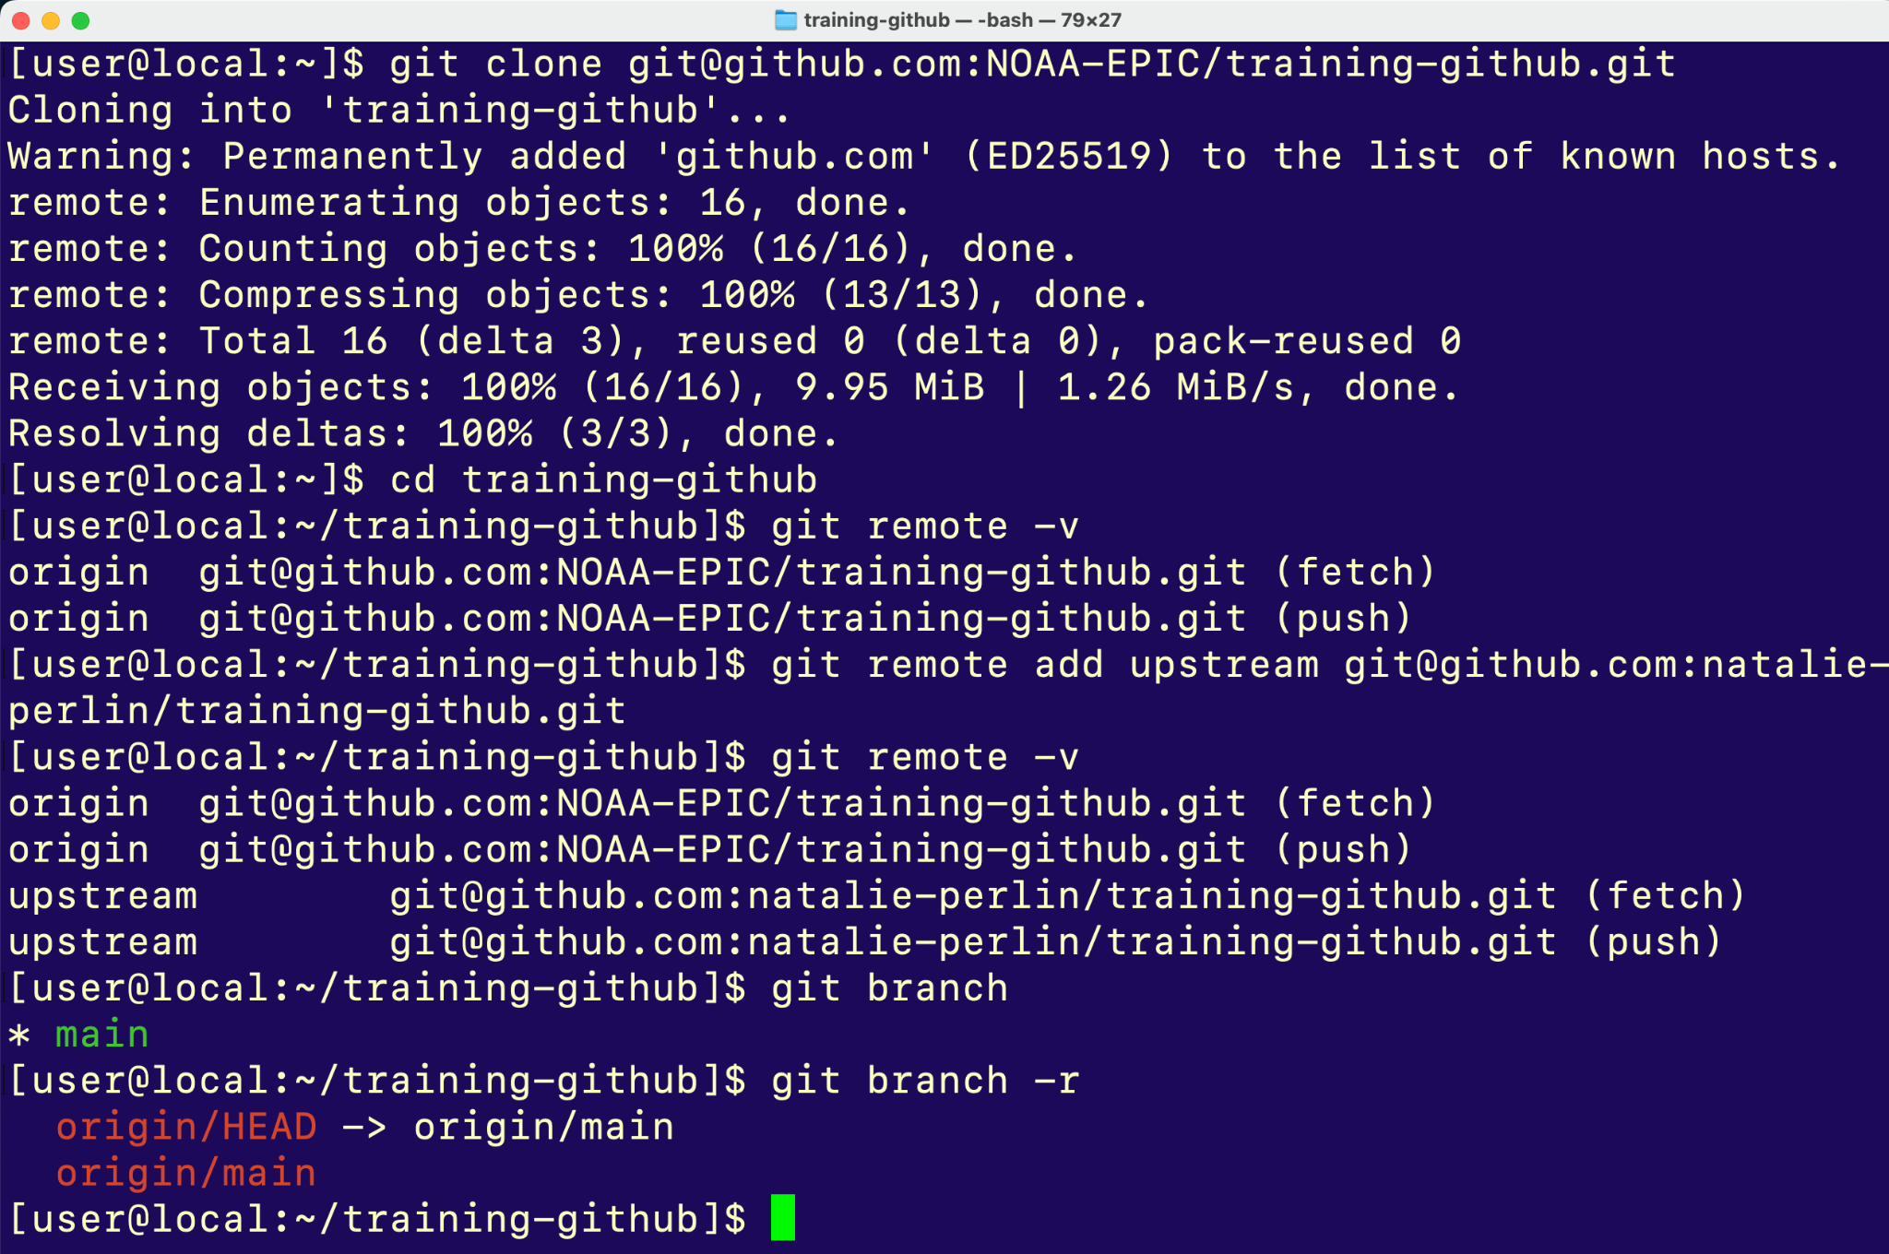
Working with remote repositories
Check out a remote repository
Add an upstream repository
Two remote repositories tracked!
origin/HEAD
default branch of the remote
origin/HEAD -> origin/main your default branch is main branch
HEAD is the symbolic reference to the branch you are currently on. (more specifically) HEAD point to the most recent commit of the working branch.
EARTH PREDICTION INNOVATION CENTER (EPIC)

Slide 24
EARTH PREDICTION INNOVATION CENTER (EPIC)

